Slide 1
Paper 1 - Theory (Chapter 7.1)
Exam Questions and Answers
Guidance:
0417/11 (2013)
0417/12 (2013)
0417/13 (2013)
0417/11 (2012)
0417/12 (2012)
0417/13 (2012)

Slide 2
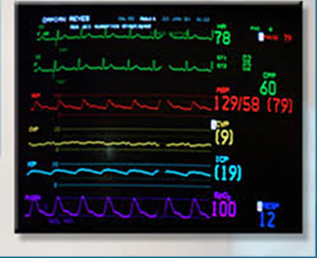
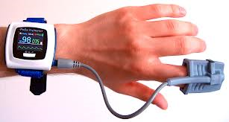
Paper Paper 1 - Theory
Chapter 7 - 0417/11 (2013)
5) Hospitals often use computers to continuously monitor patients. The pulse rate of the patient is one measurement that would be monitored.
List three other measurements that would be monitored.
Temperature
Blood pressure
Glucose level
Rate of respiration
Level of oxygen in the patient’s blood

Slide 3
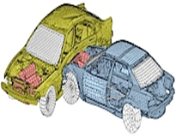
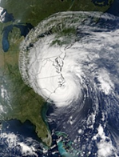
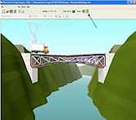
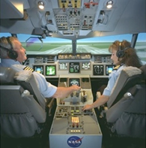
Paper Paper 1 - Theory
Chapter 7 - 0417/11 (2013)
12) E. Spreadsheets are often used to produce computer models.
Give three reasons why computer modelling is used instead of the real thing.
Some situations are/real thing might be dangerous/ model is less dangerous
Cost of building real thing may be expensive
Real thing may waste raw materials/natural resources
Easier to change/modify
Costs less to change data/variables
The real thing may be impossible to access/create
Real thing may be on too vast a scale
It may take a long time to obtain results from the real thing
Extremes which can’t be tested in real life can be tested using models

Slide 4
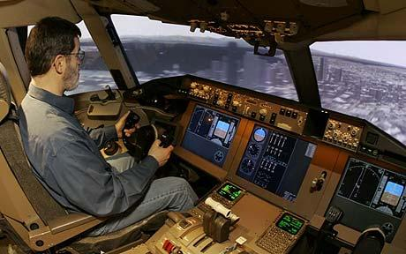
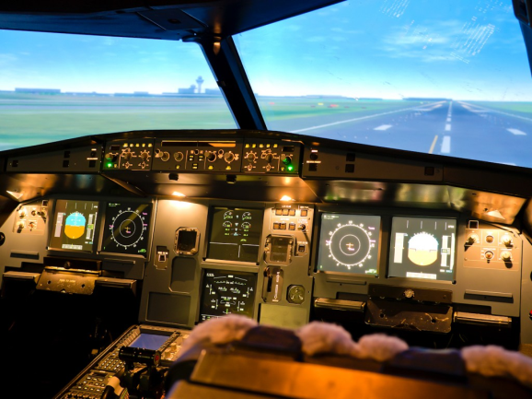
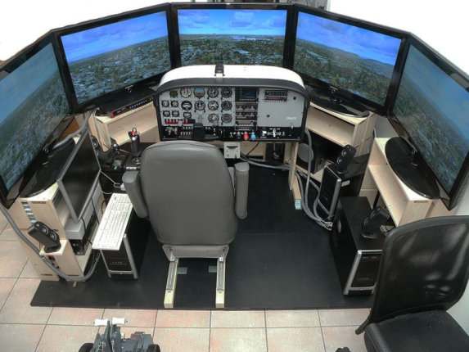
Paper Paper 1 - Theory
Chapter 7 - 0417/12 (2013)
15) F. Spreadsheets are often used to produce computer models. There are however, other forms of models such as simulations.
Explain, using air pilot training as an example, what is meant by simulation
Creating a model of a real system (such as a cockpit)…
…in order to study the behaviour of the system/pilot reactions
Is able to predict/react to the behaviour of the system or pilot
The cockpit simulation has all the controls normally found in an actual cockpit
Creating models of situations that pilots might meet in real life/Creates whatif scenarios

Slide 5
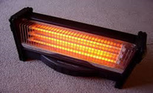
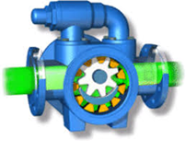
Paper Paper 1 - Theory
Chapter 7 - 0417/13 (2013)
12 A house has a microprocessor controlled central heating system.
(a) Describe the use of the following input devices in such a system.
Keypad: To input required temperature
Sensor: To input current temperature of the room
Describe how the microprocessor would use the data from these devices to control the system.
Microprocessor stores required temperature as preset value
Compares temperature from sensor to pre-set temperature
If temperature is lower than preset value microprocessor sends a signal to turn heater on
If higher than preset value microprocessor sends a signal (to the actuator) to turn heater off
If values are equal microprocessor does nothing
Wait set period of time before looping
1 - Input devices called sensors feed data into the computer
2 - The computer then processes the input data (by following a set of instructions)
3 - As a result of the processing, the computer can turn on or off output devices called actuators.

Slide 6
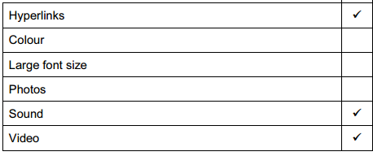
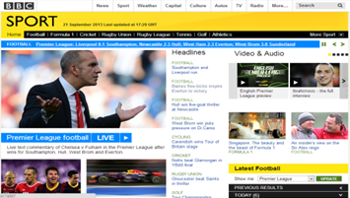
Paper Paper 1 - Theory
Chapter 7 - 0417/13 (2013)
9. A head teacher has decided that the school magazine will now be included in the school’s website.
(a) Tick three features of a website which would not be found in a magazine printed on paper.
(b) Give three other reasons why the head teacher thinks it is a good idea to replace the paper version with a website version.
Saves school cost of printing copies
Can include colour at no extra cost
Can include animated text effects
Saves cost of delivery
Audience not limited to parents of school children

Slide 7
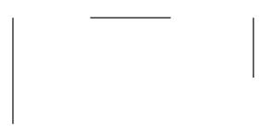
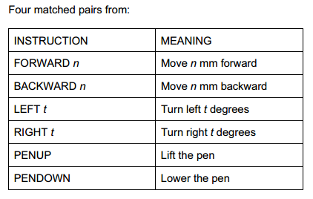
Paper Paper 1 - Theory
Chapter 7 - 0417/13 (2013)
7 A student wishes to use a floor turtle to draw this shape which has no two lines the same length:
Name four different instructions which the turtle graphics software could use in order to
draw the shape. For each one explain the meaning of the instruction.
Tip: They may actual ask you to write possible instructions and the meanings to draw the shape shown.

Slide 8
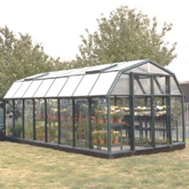
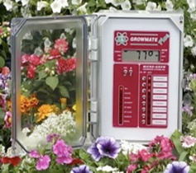
Paper Paper 1 - Theory
Chapter 7 - 0417/11 (2012)
12. A greenhouse is controlled by a microprocessor.
Other than a light sensor name two sensors used in the greenhouse
Temperature
Humidity
Moisture
pH
Explain why computers are unable to read the data directly from these sensors and name the device which would enable them to do so.
Sensor measures analogue
Computer works in digital
Analogue to digital converter
Describe how the microprocessor uses data from the light sensor
Microprocessor compares light reading with preset value
If lower than pre-set value microprocessor sends signal to switch on light bulb
If higher than pre-set value microprocessor sends signal to switch off light bulb
process is continuous/ monitoring of sensors is continuous
Sensors cannot control anything - all they can do is pass data to the computer.
The computer takes the actions and turns on/off the actuators

Slide 9
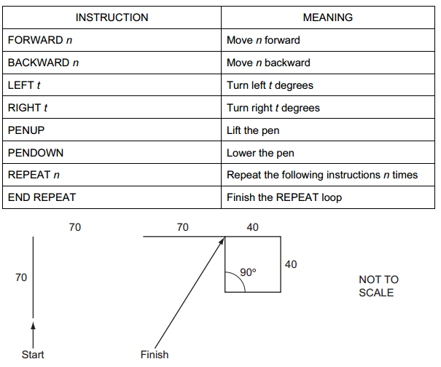
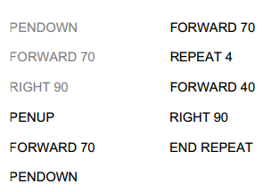
Paper Paper 1 - Theory
Chapter 7 - 0417/11 (2012)
Tip: In this question you have to write out the remaining steps.
1st: Work out how many more steps you have to get around the shape. (8)
2nd : It is possible you may have to use a repeat to draw the shape.
3rd: Remember to end the repeat.

Slide 10

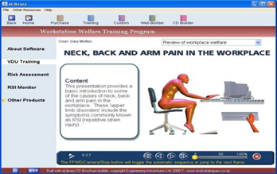
Paper Paper 1 - Theory
Chapter 7 - 0417/12 (2012)
11. The head teacher wants to replace the current printed school magazine with one slide show available on a number of machines in a computer room at parents’ evenings.
Name three features available in a slideshow not available in a hard copy magazine. For
each one say how it could be used in the school’s slideshow.
Sound: Spoken introduction by head/voiceover the presentation/background music/school
choir/band/orchestra/sound effects when changing/opening a slide
Animation: Text effects/cartoon representing school activities
Video : Introduction by head/school play/choir/band/orchestra/sports activities
Hyperlinks : Move to another slide
Slide transitions : To keep the viewer’s attention

Slide 11
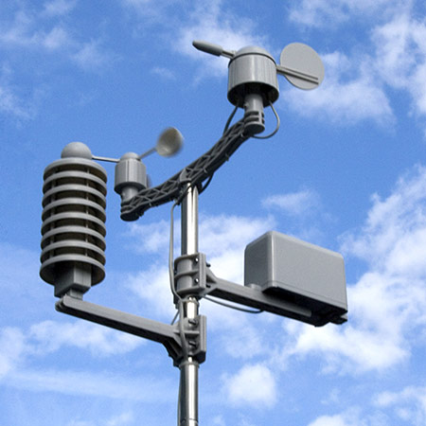
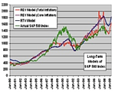
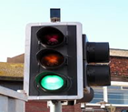
Paper Paper 1 - Theory
Chapter 7 - 0417/12 (2012)
8 A geography teacher wants to build a weather station. She wants to use a computer to
collect the results.
A) Describe three physical variables which would be measured.
Temperature
Pressure
Sunlight
Humidity
Rainfall
C) Describe three other uses of modelling.
Simulations
Mathematical models
Scientific models
Civil engineering models
Financial models
Flight/pilot simulation/training
Large scale chemical experiments
Design of fairground rides
Traffic control
Building fire simulation

Slide 12
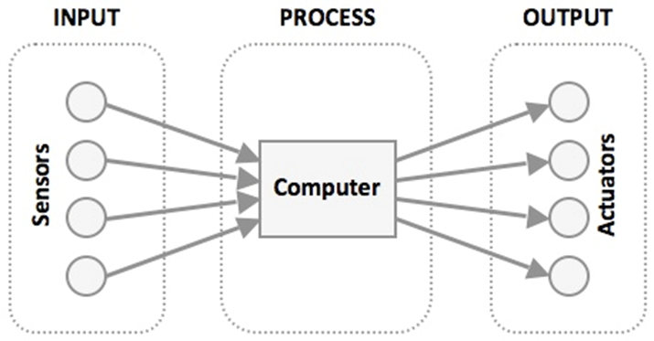
Paper Paper 1 - Theory
Chapter 7 - 0417/13 (2012)
8) A greenhouse is controlled by a microprocessor.
B) Explain the difference between measurement and control.
Measurement is the monitoring of physical variables without the microprocessor taking action.
Control is when the microprocessor takes action depending on sensor readings
C) Give four advantages of using a computer rather than allowing the students to control
the growing conditions.
Computer (readings) are more accurate than students
Students might forget to take readings/readings can be taken at regular intervals
Computer takes more reliable readings
Readings can be taken/control can be carried out more frequently
Readings can be taken/control can be carried out any time of day or night
Computers can respond to changes immediately/quicker than students
Students might be unavailable to take readings during school holidays/computers can work
continuously/without taking a break
Measurement - Sensors
Control - Actutators

